Slide 1

MIS710 Machine Learning in Business EDA

Slide 2

Exploratory Data Analysis (EDA)
Data understanding
Data cleaning
Feature engineering
Anomaly detection

Slide 3

Steps
Data collection
Data inspection
Data visualisation
Handling missing values and outliers
Summary statistics

Slide 4

Data collection
Data sources
Loading data using pandas
pd.read_csv()
Data integrity and quality checks

Slide 5

Data inspection
Data quality
Structure
Number of rows and columns)
Data type
Missing values
Useful functions:
pd.head(), pd.info(), pd.isnull()

Slide 6

Summary statistics
Central tendency
Mean, median
Spread
Stadard deviation, range, interquartile range
Distribution
Percentiles, skewness, kurtosis

Slide 7
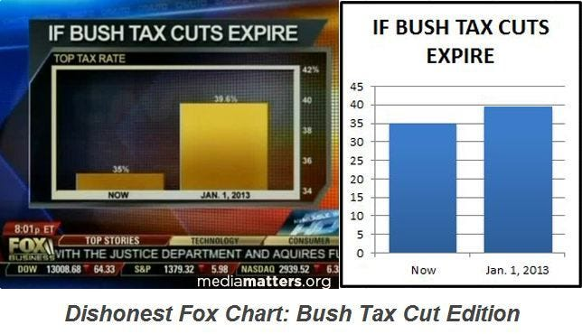
Data visualisation
Importance of data visualisation
Visualisation techniques
Misleading visualisations

Slide 8
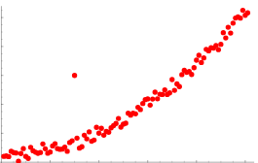
Handling missing values and outliers
Handling missing values
Imputation, deletion
Advanced techniques
Handling outliers
Identify outliers (z-score, visualization)
Winsorisation, trimming, transformation

